Slide 1

The Pokemon Dataset
Mateusz Rock
Grzegorz Meller
Robert Zwierzycki
Tomasz Wierciński

Slide 2
Presentation Outline
General Description of dataset
Description of attributes
Exploratory data analysis
Data quality
Preliminary goals for further data mining

Slide 3


General Description of dataset
This dataset contains information on all 800 Pokemon from all Seven Generations of Pokemon.
The dataset include:
Base Stats, Attack and Defense points,
Speed of Pokemon, Hitpoints,
Legendary Status Classification,
Pokemon Combats Results

Slide 4

Description of attributes
Type1: First attack type:
about 17 different types of attack like ice, rock, poison.
Type2: Second attack type:
about 19 different types of attack like ground,rock,flying.
Generation:
Development stage of a pokemon, there are about 6 generation levels in the dataset.
Legendary:
About 8% of the pokemon from the dataset are legendary pokemons.

Slide 5

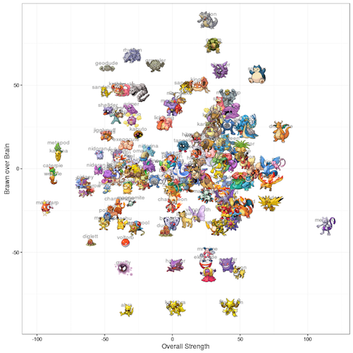
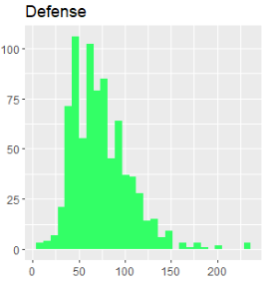
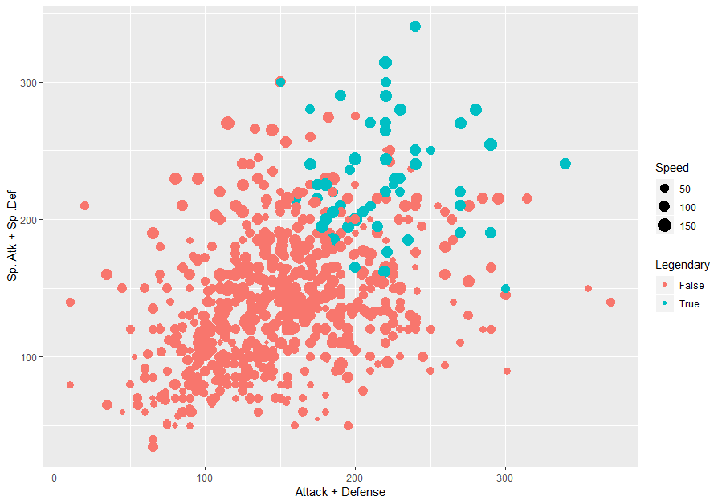
Exploratory Data Analysis
Distributions of attribute values are close to normal, but we can clearly see that there are outliers.
It is possible to distinguish between legendary and non-legendary Pokemon by comparing their attack and defense with special attack force and defense points

Slide 6
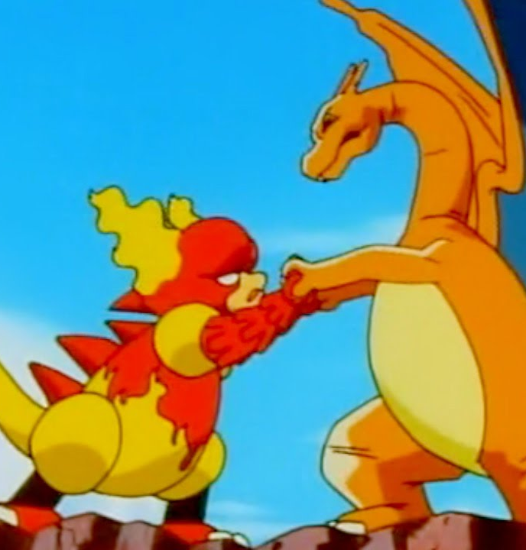
Data Quality
The amount of missing data - NO MISSING DATA However there are some Pokemon that do not have Second attack type.
Outliers - we can see outliers on histograms
Overall data integrity

Slide 7

Preliminary goals for further data mining
With this dataset, we want to answer the following questions:
Is it possible to build a classifier to identify legendary Pokemon?
Which type is the strongest overall? Which is the weakest?
Which type is the most likely to be a legendary Pokemon?
Can you build a Pokemon dream team (6 pokemons)?
Will you be able to predict the outcome of future combats?

